Slide 1
Chapter 5: Procedures

Slide 2
Procedures
As programs get larger and larger, it becomes necessary to divide them into a series of procedures.
A procedure is a block of logically-related instruction that can be called by the main program or another procedure.
Each procedure should have a single purpose and be able to do its job independent of the rest of the program.

Slide 3
Why Are Procedures Important?
You need them to do input-output in assembly language.
Procedures help you gain major insight into how the runtime stack is used.
Your programs will grow to the point where you either divide them into procedures or you never understand the whole program.

Slide 4
Chapter Overview
Linking to an External Library
The Book's Link Library
Stack Operations
Defining and Using Procedures

Slide 5
Link Library Overview
A file containing procedures that have been compiled into machine code
  constructed from one or more OBJ files
To build a library, . . .
  start with one or more ASM source files
  assemble each into an OBJ file
  create an empty library file (extension .LIB)
  add the OBJ file(s) to the library file, using the Microsoft LIB utility
Take a quick look at Irvine32.asm in the \MASM615 folder.

Slide 6
Calling a Library Procedure
Call a library procedure using the CALL instruction. Some procedures require input arguments. The INCLUDE directive copies in the procedure prototypes (declarations).
The following example displays "1234" on the console:
INCLUDE Irvine32.inc
.code
mov eax,1234h ; input argument
call WriteHex ; show hex number
call Crlf ; end of line

Slide 7
Linking to a Library
Your programs link to Irvine32.lib using the linker command inside a batch file named make32.bat.
Notice the two LIB files: Irvine32.lib, and kernel32.lib
  the latter is part of the Microsoft Win32 Software Development Kit (SDK), contain linking information for system functions located in kernel32.dll
LINK32 %1.obj irvine32.lib kernel32.lib /SUBSYSTEM:CONSOLE /DEBUG
A bridge to kernel32.dll

Slide 8
What's Next
Linking to an External Library
The Book's Link Library
Stack Operations
Defining and Using Procedures

Slide 9
Library Procedures - Overview (1 of 5)
CloseFile – Closes an open disk file
Clrscr - Clears console, locates cursor at upper left corner
CreateOutputFile - Creates new disk file for writing in output mode
Crlf - Writes end of line sequence to standard output
Delay - Pauses program execution for n millisecond interval
DumpMem - Writes block of memory to standard output in hex
DumpRegs – Displays general-purpose registers and flags (hex)
GetCommandtail - Copies command-line args into array of bytes
GetDateTime – Gets the current date and time from the system
GetMaxXY - Gets number of cols, rows in console window buffer
GetMseconds - Returns milliseconds elapsed since midnight

Slide 10
Library Procedures - Overview (2 of 5)
GetTextColor - Returns active foreground and background text colors in the console window
Gotoxy - Locates cursor at row and column on the console
IsDigit - Sets Zero flag if AL contains ASCII code for decimal digit (0–9)
MsgBox, MsgBoxAsk – Display popup message boxes
OpenInputFile – Opens existing file for input
ParseDecimal32 – Converts unsigned integer string to binary
ParseInteger32 - Converts signed integer string to binary
Random32 - Generates 32-bit pseudorandom integer in the range 0 to FFFFFFFFh
Randomize - Seeds the random number generator
RandomRange - Generates a pseudorandom integer within a specified range
ReadChar - Reads a single character from standard input

Slide 11
Library Procedures - Overview (3 of 5)
ReadDec - Reads 32-bit unsigned decimal integer from keyboard
ReadFromFile – Reads input disk file into buffer
ReadHex - Reads 32-bit hexadecimal integer from keyboard
ReadInt - Reads 32-bit signed decimal integer from keyboard
ReadKey – Reads character from keyboard input buffer
ReadString - Reads string from standard input, terminated by [Enter]
SetTextColor - Sets foreground and background colors of all subsequent console text output
Str_compare – Compares two strings
Str_copy – Copies a source string to a destination string
StrLength – Returns length of a string
Str_trim - Removes unwanted characters from a string.

Slide 12
Library Procedures - Overview (4 of 5)
Str_ucase - Converts a string to uppercase letters.
WaitMsg - Displays message, waits for Enter key to be pressed
WriteBin - Writes unsigned 32-bit integer in ASCII binary format.
WriteBinB – Writes binary integer in byte, word, or doubleword format
WriteChar - Writes a single character to standard output
WriteDec - Writes unsigned 32-bit integer in decimal format
WriteHex - Writes an unsigned 32-bit integer in hexadecimal format
WriteHexB – Writes byte, word, or doubleword in hexadecimal format
WriteInt - Writes signed 32-bit integer in decimal format

Slide 13
Library Procedures - Overview (5 of 5)
WriteStackFrame - Writes the current procedure’s stack frame to the console.
WriteStackFrameName - Writes the current procedure’s name and stack frame to the console.
WriteString - Writes null-terminated string to console window
WriteToFile - Writes buffer to output file
WriteWindowsMsg - Displays most recent error message generated by MS-Windows

Slide 14
Irvine Library Help
A Windows help file showing:
Irvine Library Procedures
Procedure Purpose
Calling & Return Arguments
Example of usage
Some other information (we will use later)
IrvineLibHelp.chm

Slide 15
Example 1
Clear the screen, delay the program for 500 milliseconds, and dump the registers and flags.
INCLUDE Irvine32.inc
.code
call Clrscr
mov eax,500
call Delay
call DumpRegs
Sample output:
EAX=00000613 EBX=00000000 ECX=000000FF EDX=00000000
ESI=00000000 EDI=00000100 EBP=0000091E ESP=000000F6
EIP=00401026 EFL=00000286 CF=0 SF=1 ZF=0 OF=0

Slide 16
Example 2
Display a null-terminated string and move the cursor to the beginning of the next screen line.
INCLUDE Irvine32.inc
.data
str1 BYTE "Assembly language is easy!",0
.code
mov edx,OFFSET str1
call WriteString
call Crlf

Slide 17
Example 2a
Display a null-terminated string and move the cursor to the beginning of the next screen line (use embedded CR/LF)
INCLUDE Irvine32.inc
.data
str1 BYTE "Assembly language is easy!",0Dh,0Ah,0
.code
mov edx,OFFSET str1
call WriteString

Slide 18
Example 3
Display an unsigned integer in binary, decimal, and hexadecimal, each on a separate line.
INCLUDE Irvine32.inc
IntVal = 35
.code
mov eax,IntVal
call WriteBin ; display binary
call Crlf
call WriteDec ; display decimal
call Crlf
call WriteHex ; display hexadecimal
call Crlf
Sample output:
0000 0000 0000 0000 0000 0000 0010 0011
35
00000023

Slide 19
Example 4
Input a string from the user. EDX points to the string and ECX specifies the maximum number of characters the user is permitted to enter.
INCLUDE Irvine32.inc
.data
fileName BYTE 80 DUP(0)
.code
mov edx,OFFSET fileName
mov ecx,SIZEOF fileName – 1
call ReadString
A null byte is automatically appended to the string.

Slide 20
Example 5
Generate and display ten pseudorandom signed integers in the range 0 – 99. Pass each integer to WriteInt in EAX and display it on a separate line.
INCLUDE Irvine32.inc
.code
mov ecx,10 ; loop counter
L1: mov eax,100 ; ceiling value
call RandomRange ; generate random int
call WriteInt ; display signed int
call Crlf ; goto next display line
loop L1 ; repeat loop

Slide 21
Example 6
Display a null-terminated string with yellow characters on a blue background.
INCLUDE Irvine32.inc
.data
str1 BYTE "Color output is easy!",0
.code
mov eax,yellow + (blue * 16)
call SetTextColor
mov edx,OFFSET str1
call WriteString
call Crlf
The background color is multiplied by 16 before being added to the foreground color.

Slide 22
;-----------------------------------
; Standard 4-bit color definitions, ;inside Irvine32.inc
;-----------------------------------
black = 0000b
blue = 0001b
green = 0010b
cyan = 0011b
red = 0100b
magenta = 0101b
brown = 0110b
lightGray = 0111b
gray = 1000b
lightBlue = 1001b
lightGreen = 1010b
lightCyan = 1011b
lightRed = 1100b
lightMagenta = 1101b
yellow = 1110b
white = 1111b

Slide 23
What's Next
Linking to an External Library
The Book's Link Library
Stack Operations
Defining and Using Procedures

Slide 24
Stack Operations
Runtime Stack
PUSH Operation
POP Operation
PUSH and POP Instructions
Using PUSH and POP
Example: Reversing a String
Related Instructions

Slide 25
Runtime Stack
Imagine a stack of plates . . .
  plates are only added to the top
  plates are only removed from the top
  LIFO structure

Slide 26
Runtime Stack
The runtime stack is a memory array that is managed by the CPU, using two registers
  SS (stack segment)
  ESP (stack pointer) *
* SP in Real-address mode

Slide 27
The Intel Processor’s Stack
The stack in an Intel processor is a special memory area.
  The stack is a temporary holding area for addresses and data.
  Most of the data held here allows a program to return (successfully) to the calling program and procedures or to pass parameters.
  The stack resides in the stack segment.

Slide 28
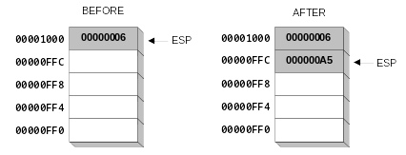
PUSH Operation
A 32-bit push operation decrements the stack pointer by 4 and copies a value into the location pointed to by the stack pointer.

Slide 29
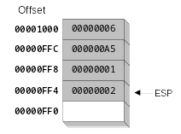
PUSH Operation (cont’d)
Same stack after pushing two more integers:
The stack grows downward. The area below ESP is always available (unless the stack has overflowed).

Slide 30
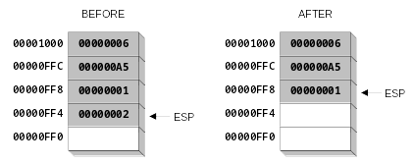
POP Operation
Copies value at stack[ESP] into a register or variable.
Adds n to ESP, where n is either 2 or 4.
  value of n depends on the attribute of the operand receiving the data

Slide 31
Uses of the Stack
There are several important uses of stacks in programs:
  A stack makes an excellent temporary save area for registers, allowing a program to use them as a scratch area and then to restore them.
  When a subroutine is called, the CPU saves a return address on the stack, allowing the program to return to the location after the procedure call.
  When calling a procedure, you can push arguments on the stack , allowing the procedure to retrieve them.
  High-level languages create an area on the stack inside subroutines where procedure store local variables and discard them when it leaves the procedure.

Slide 32
PUSH and POP Instructions
PUSH syntax:
  PUSH r/m16
  PUSH r/m32
  PUSH imm32
POP syntax:
  POP r/m16
  POP r/m32
Immediate values are always 32 bits in 32-bit mode

Slide 33
Using PUSH and POP
Save and restore registers when they contain important values. PUSH and POP instructions occur in the opposite order.
push esi ; push registers
push ecx
push ebx
mov esi,OFFSET dwordVal ; display some memory
mov ecx,LENGTHOF dwordVal
mov ebx,TYPE dwordVal
call DumpMem
pop ebx ; restore registers
pop ecx
pop esi

Slide 34
Example: Nested Loop
When creating a nested loop, push the outer loop counter before entering the inner loop:
mov ecx,100 ; set outer loop count
L1: ; begin the outer loop
push ecx ; save outer loop count
mov ecx,20 ; set inner loop count
L2: ; begin the inner loop
;
;
loop L2 ; repeat the inner loop
pop ecx ; restore outer loop count
loop L1 ; repeat the outer loop

Slide 35
Nested Loop
If you need to code a loop within a loop, you must save the outer loop counter's ECX value. In the following example, the outer loop executes 100 times, and the inner loop 20 times.
.data
count DWORD ?
.code
mov ecx,100 ; set outer loop count
L1:
mov count,ecx ; save outer loop count
mov ecx,20 ; set inner loop count
L2: .
  .
  loop L2 ; repeat the inner loop
mov ecx,count ; restore outer loop count
loop L1 ; repeat the outer loop

Slide 36
Example: Reversing a String
Use a loop with indexed addressing
Push each character on the stack
Start at the beginning of the string, pop the stack in reverse order, insert each character back into the string
Source code
Q: Why must each character be put in EAX before it is pushed?
Because only word (16-bit) or doubleword (32-bit) values can be pushed on the stack.

Slide 37
Related Instructions
PUSHFD and POPFD
  push and pop the 32-bit EFLAGS register
  PUSHF and POPF the 16-bit FLAGS register
PUSHAD pushes the 32-bit general-purpose registers on the stack
  order: EAX, ECX, EDX, EBX, ESP, EBP, ESI, EDI
POPAD pops the same registers off the stack in reverse order
  PUSHA and POPA do the same for 16-bit registers
No Operands!!!!!

Slide 38
What's Next
Linking to an External Library
The Book's Link Library
Stack Operations
Defining and Using Procedures

Slide 39
Defining and Using Procedures
Creating Procedures
Documenting Procedures
Example: SumOf Procedure
CALL and RET Instructions
Nested Procedure Calls
Local and Global Labels
Procedure Parameters
Flowchart Symbols
USES Operator

Slide 40
Creating Procedures
Large problems can be divided into smaller tasks to make them more manageable
A procedure is the ASM equivalent of a Java or C++ function
Following is an assembly language procedure named sample:
sample PROC
  .
  .
  ret
sample ENDP

Slide 41
Procedures
In general, there are two types of subprograms: functions and procedures (or subroutines).
  Functions return a value (or result).
  Procedures (or subroutines) do not.
  The terms procedures and subroutines are used interchangeably although some languages use one term and others use the other.
  Calling a procedure implies that there is a return. Also implies is that the state of the program, (register values, etc.) are left unaffected when the program returns to the calling procedure or program.

Slide 42
PROC and ENDP Directives
PROC and ENDP mark the beginning and end of a procedure respectively.
  .code
  main proc
  … …
  call MySub
  … …
  main endp
  MySub proc
  …
  ret
  MySub endp
Note: procedures cannot overlap. One must have endp before the next can have proc

Slide 43
Documenting Procedures
Suggested documentation for each procedure:
A description of all tasks accomplished by the procedure.
Receives: A list of input parameters; state their usage and requirements.
Returns: A description of values returned by the procedure.
Requires: Optional list of requirements called preconditions that must be satisfied before the procedure is called.
If a procedure is called without its preconditions satisfied, it will probably not produce the expected output.

Slide 44
Example: SumOf Procedure
;---------------------------------------------------------
SumOf PROC
;
; Calculates and returns the sum of three 32-bit integers.
; Receives: EAX, EBX, ECX, the three integers. May be
; signed or unsigned.
; Returns: EAX = sum, and the status flags (Carry,
; Overflow, etc.) are changed.
; Requires: nothing
;---------------------------------------------------------
  add eax,ebx
  add eax,ecx
  ret
SumOf ENDP

Slide 45
CALL and RET Instructions
The CALL instruction calls a procedure
  pushes offset of next instruction on the stack
  copies the address of the called procedure into EIP
The RET instruction returns from a procedure
  pops top of stack into EIP

Slide 46
CALL-RET Example
main PROC
  00000020 call MySub
  00000025 mov eax,ebx
  .
  .
main ENDP
MySub PROC
  00000040 mov eax,edx
  .
  .
  ret
MySub ENDP
0000025 is the offset of the instruction immediately following the CALL instruction
00000040 is the offset of the first instruction inside MySub

Slide 47

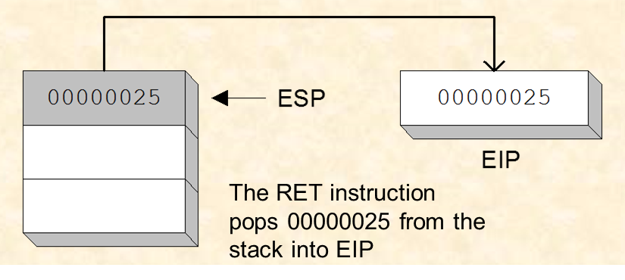
CALL-RET Example (cont’d)
The CALL instruction pushes 00000025 onto the stack, and loads 00000040 into EIP
main PROC
  00000020 call MySub
  00000025 mov eax,ebx
  ..
main ENDP
MySub PROC
  00000040 mov eax,edx
  ..
  ret
MySub ENDP
(stack shown before RET executes)

Slide 48
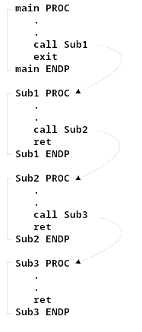
Nested Procedure Calls
By the time Sub3 is called, the stack contains all three return addresses:

Slide 49
Labels in Procedure: Local vs Global
Be default, code labels have local scope, limited to the procedures in which they are located.
• By ending a label with a double colon, the scope become global and it can be referenced outside the current procedure.
main PROC
jmp L2 ; error
L1:: ; global label
exit
main ENDP
sub2 PROC
L2: ; local label
jmp L1 ; ok
ret
sub2 ENDP

Slide 50
Procedure Parameters (1 of 3)
A good procedure might be usable in many different programs
  but not if it refers to specific variable names
Parameters help to make procedures flexible because parameter values can change at runtime

Slide 51
Procedure Parameters (2 of 3)
The ArraySum procedure calculates the sum of an array. It makes two references to specific variable names:
ArraySum PROC
  mov esi,0 ; array index
  mov eax,0 ; set the sum to zero
mov ecx,LENGTHOF myarray ; set number of elements
L1: add eax,myArray[esi] ; add each integer to sum
  add esi,4 ; point to next integer
  loop L1 ; repeat for array size
  mov theSum,eax ; store the sum
ret
ArraySum ENDP
What if you wanted to calculate the sum of two or three arrays within the same program?

Slide 52
Passing arguments in registers
The most common method for passing parameter between the calling program (or procedure) and the procedures that it calls is through the registers
It is efficient because the called procedure has immediate and direct use of the parameters and registers are faster than memory.

Slide 53
Procedure Parameters (3 of 3)
This version of ArraySum returns the sum of any doubleword array whose address is in ESI. The sum is returned in EAX:
ArraySum PROC
; Receives: ESI points to an array of doublewords,
; ECX = number of array elements.
; Returns: EAX = sum
;-----------------------------------------------------
  mov eax,0 ; set the sum to zero
L1: add eax,[esi] ; add each integer to sum
  add esi,4 ; point to next integer
  loop L1 ; repeat for array size
ret
ArraySum ENDP

Slide 54
Procedure Parameters (3 of 3)
This version of ArraySum returns the sum of any doubleword array whose address is in ESI. The sum is returned in EAX:
ArraySum PROC
; Receives: ESI points to an array of doublewords,
; ECX = number of array elements.
; Returns: EAX = sum
;-----------------------------------------------------
  mov eax,0
L1: add eax,[esi]
  add esi,4
  loop L1
ret
ArraySum ENDP
ArraySum PROC
  mov esi,0
  Mov the sum to zero
mov ecx,LENGTHOF myarray
L1: add eax,myArray[esi]
  add esi,4
  loop L1
  mov theSum,eax
ret
ArraySum ENDP

Slide 55
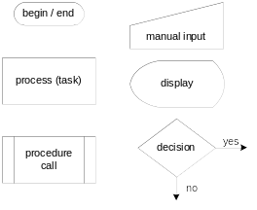
Flowchart Symbols
Flowchart is a way of diagramming program logic. Each shape in a flowchart represents a single logical step.
The following symbols are the basic building blocks of flowcharts:
(Includes two symbols not listed on page 166 of the book.)

Slide 56
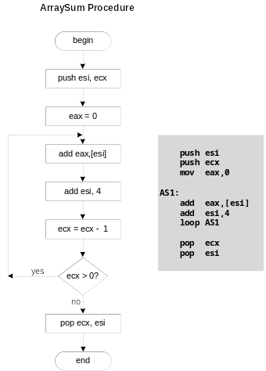
Flowchart for the ArraySum Procedure
AS1:

Slide 57
USES Operator
Coupled with PROC.
Lists the registers that will be modified and their previous values will be restored automatically through push and pop operations.
ArraySum PROC USES esi ecx ;using space not comma
mov eax,0 ; set the sum to zero
etc.
USES tells MASM to do two things: generate push instructions and then generate pop instructions, thus MASM generates the code shown in blue:
ArraySum PROC
push esi
push ecx
.
.
pop ecx
pop esi
ret
ArraySum ENDP

Slide 58
When not to push a register
When a procedure return a value in a register, this register should not be pushed or popped.
e.g., The sum of the three registers is stored in EAX on line (3), but the POP instruction replaces it with the starting value of EAX on line (4):
SumOf PROC ; sum of three integers
  push eax ; 1
  add eax,ebx ; 2
  add eax,ecx ; 3
  pop eax ; 4
  ret
SumOf ENDP

Slide 59
What's Next
Linking to an External Library
The Book's Link Library
Stack Operations
Defining and Using Procedures
Program Design Using Procedures

Slide 60
Program Design Using Procedures
Not code all tasks in a single procedure
  Difficult to read and maintain
  Separate procedure for each task
Top-Down Design (functional decomposition) involves the following:
  design your program before starting to code
  break large tasks into smaller ones
    Easy to read and maintain
  use a hierarchical structure based on procedure calls
  test individual procedures separately

Slide 61
Integer Summation Program (1 of 4)
Description: Write a program that prompts the user for multiple 32-bit integers, stores them in an array, calculates the sum of the array, and displays the sum on the screen.
Main steps:
Prompt user for multiple integers
Calculate the sum of the array
Display the sum

Slide 62
Procedure Design (2 of 4)
Main
Clrscr ; clear screen
PromptForIntegers
WriteString ; display string
ReadInt ; input integer
ArraySum ; sum the integers
DisplaySum
WriteString ; display string
WriteInt ; display integer

Slide 63
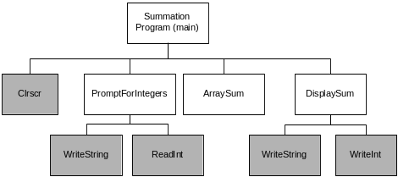
Structure Chart (3 of 4)
gray indicates library procedure
View the stub program
View the final program

Slide 64
Sample Output (4 of 4)
Enter a signed integer: 550
Enter a signed integer: -23
Enter a signed integer: -96
The sum of the integers is: +431

